Slide 1

Transformation at Scale
Through DPI
Tanushka Vaid
Senior Program Officer, CDPI
Content of this deck is licensed under CC BY-SA 4.0

Slide 2




Academic & Non Profit
Centre under IIIT-B University
Tech Architecture Advisory
Pro bono, software neutral
Global Action Bias
Team of practitioners
Who we are at
the Centre for DPI
Notes:
Codevelop Funded us

Slide 3
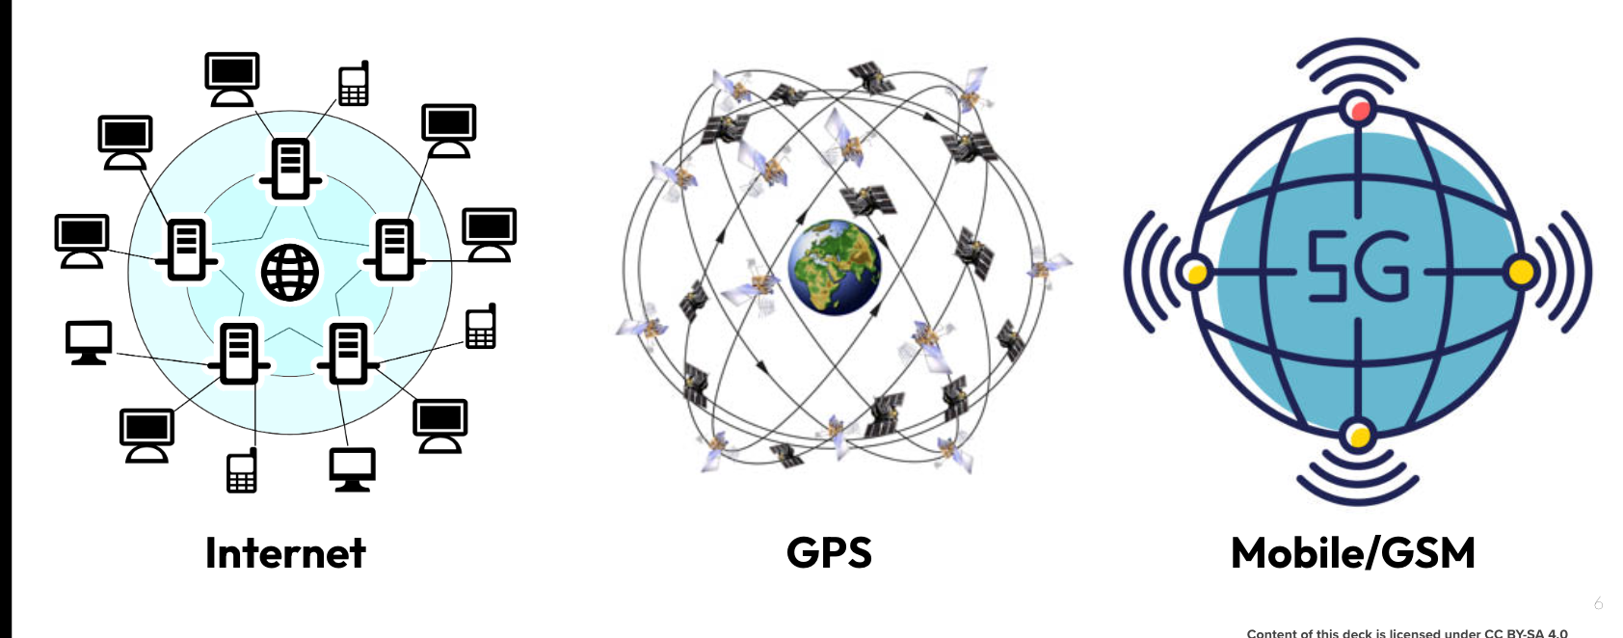
DPI drives exponential change
Physical Infrastructure
Railways, Roads, Cell Towers, Internet cables
Both
drive
Public & Private
Innovation
Digital Infrastructure
to catalyse digital
services
Open tech standards & interoperable systems
Content of this deck is licensed under CC BY-SA 4.0

Slide 4







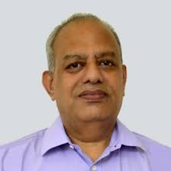










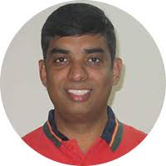
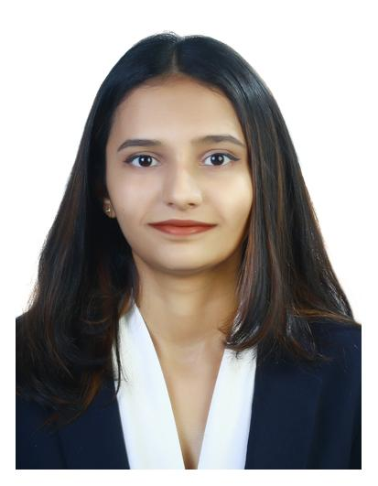




Our Team is our core strength: 16 people. 8 languages. 8 countries. 5 continents.
Dr. Pramod Varma
Co-Chair
Manuel Aguilera
Ana Maria
Bermudez
Vineet Bhandari
Prof. S. Rajagopalan
Chair
Nidia Martinez Quezada
Daniel Abadie
Samantha Achieng
Kamya Chandra
Tanushka Vaid
Lina Hadboun
Antony Muriithi
Daniel Amewor
Fithya Findie
Vijay Vujjini
Anusree Jayakrishnan
Notes:
English
Portuguese
Swahili
Spanish
French
Hindi
Telugu
Malayalam

Slide 5


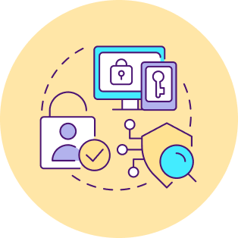



Foundational Digital Public Infra Categories
within & across sectors that you could build on
5
Payments
Trust Infra
Discovery & Fulfillment
Identities
Data Sharing & Credentials
Authenticating any noun in a digital ecosystem (people, entities, & objects) via Registries
Making financial transactions with ease
Sharing Data (history, profile, & attributes) or Models peer to peer or publicly
Enabling trust through signatures, consent, and beyond
Accessing goods and services via open protocols/APIs
Examples
Nandan Nilekani, 2024

Slide 6



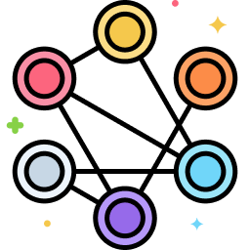

DPI Architecture Principles
make digitisation inclusive & scalable
5
1.
2.
3.
4.
5.
Interoperability driven by open specifications
Minimalist, Reusable building blocks rather than end-to-end solutions
Diverse, inclusive innovation by the ecosystem via open & multi-modal access
Federated & Decentralized with a preference for letting data stay where it’s been collected
Security & Privacy by design; a trust-no-one architecture
Content of this deck is licensed under CC BY-SA 4.0

Slide 7


How CDPI Works with countries
Two tracks of country engagement
Country’s existing vendor executes
Co-create strategy/
approach
with CDPI
Advise towards Execution at Country Pace
I
Country gets a new vendor at its own pace
II
Rapid DPI Upgrade using Configurable packages (DaaS)
DaaS funds Open Source Provider (DPG) + SP to execute Phase 1 rapidly

Slide 8





















Funder
Country Implementation/
Advocacy
Researcher
CDPI partners with institutions for global DPI implementation and advocacy

